Slide 1
Ghostbusters (2016) Game Evaluation Report
May 15, 2019
Marjorie Ann Cuerdo
Frauline Agarin
HCI 590: Games User Research
DePaul College of Computing and Digital Media

Slide 2
Overview
Executive Summary
Competitive Review
Heuristic Review
Usability Test
Playtest

Slide 3
Executive Summary
Ghostbusters (2016) is a twin-stick action shooter video game. We examined the game on the Xbox One platform through four stages.
Competitive Review
Tier 1 competitors were other Ghostbusters-themed games.
Tier 2 were other movie-based third-person action shooters.
Tier 3 were other purely top-down isometric third-person action shooters.
We found that Ghostbusters (2016) was unique in being the only movie-based top-down isometric third-person action shooter, apart from Reservoir Dogs: Bloody Days (2017).
Heuristic Review
We used Sauli Laitinen’s game heuristics (2008) based on Jakob Nielsen’s heuristics. We found that most of the usability and gameplay heuristics were violated in the game, as the underlying critical issue was that the game’s main goals and objectives were unclear. Lack of appropriate feedback and help to the player can cause confusion as to how mechanics/controls relate to the scoring system.

Slide 4
Executive Summary
Usability Test
Although players felt confident due to the simplified gameplay, this test round confirmed the heuristic review findings that there would be usability issues. Players found objectives, controls/mechanics, and navigating the game user interface and maps to be confusing and detrimental.
Playtest
In assessing the game’s playability, we found that players enjoyed the game’s aesthetics and found AI teammates to be helpful. However, it’s critical that most players found the overall gameplay to be repetitive and not fun, leading them to say the levels were too long. Most players weren’t motivated to continue playing the game after the tutorial level. The major usability issues revealed in the last round were found to result in overall dissatisfaction with the player experience.
We have provided recommendations to specifically address these issues to improve on the foundation that Ghostbusters (2016) currently has for a better player experience.

Slide 5


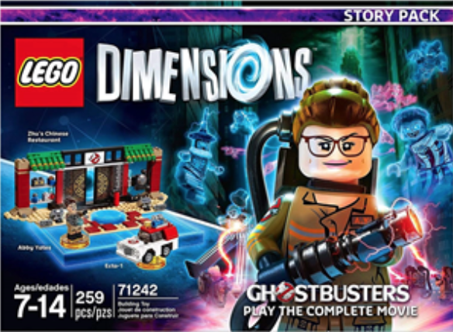
Competitive Review: Tier 1 Competitors Related Ghostbusters franchise games
Ghostbusters: Sanctum of Slime (2011)
Co-op twin stick shooter
Local and online co-op multiplayer modes
AI teammate options
No weapon upgrades
No cutscenes or voice narration
2. Ghostbusters: The Video Game (2009)
Third-person shooter (Nintendo DS is top-down)
Local and online multiplayer modes
Weapon upgrades available
3 difficulty levels: normal, experienced, professional
Uses same characters from Ghostbusters II
Lego Dimensions: Ghostbusters Story Pack (2016)
Action-adventure 3D platformer
2-player local co-op
Weapon and character upgrades available
Uses same characters from Ghostbusters (2016)

Slide 6


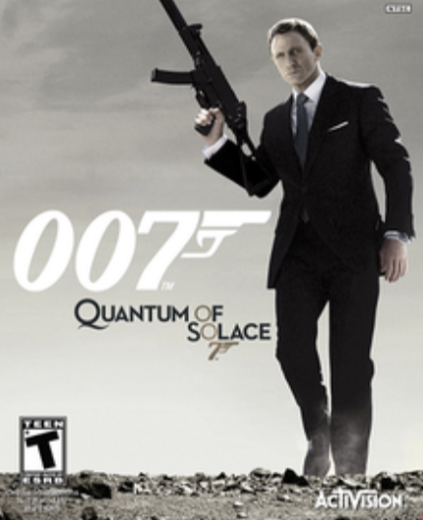
Competitive Review: Tier 2 Competitors Movie-based action shooter games
Reservoir Dogs: Bloody Days (2017)
Top-down isometric third person shooter
No multiplayer modes; 1 player for 3 characters
Defeat enemy waves for every level
No cutscenes or voice narration
2. Star Wars Battlefront II (2017)
Switch between third- and first-person
Campaign: solo; has other multiplayer modes
Has player upgrades
3 difficulty levels: explorer -> soldier -> special forces
Uses same characters from franchise and cutscenes
007: Quantum of Solace (2008)
First-person: PC, PS3, Xbox 360
Third-person: Nintendo DS and PS2
2-4 players in local and online co-op multiplayer (Wii)
Weapon and character upgrades available
Uses voice acting, dialogue, and events from movies

Slide 7
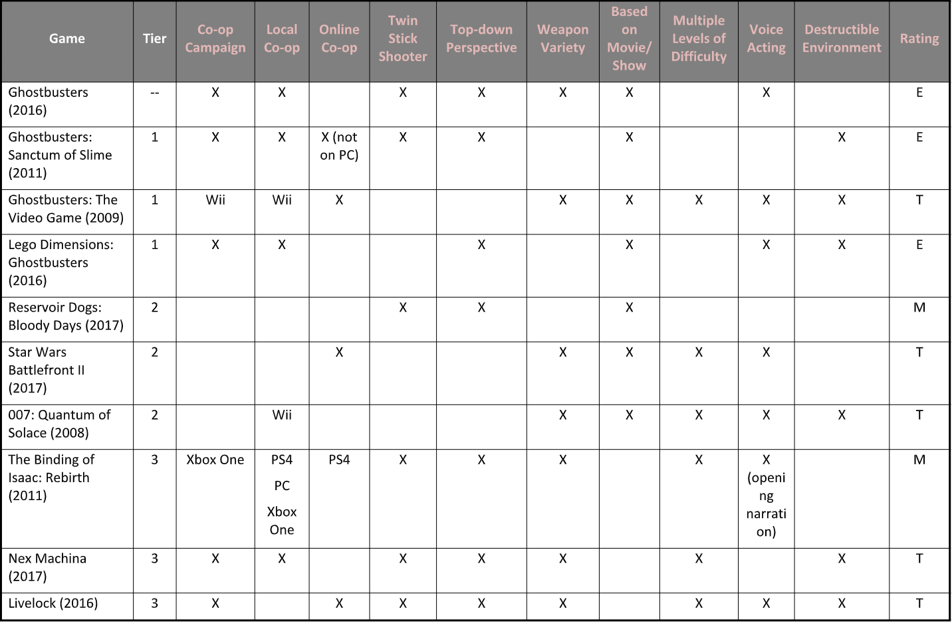
Competitive Review: Summary

Slide 8
Heuristic Review
We used Sauli Laitinen’s game heuristics (2008) based on Jakob Nielsen’s heuristics. These heuristics are split between usability and gameplay.
We found that most of the usability and gameplay heuristics were violated in the game:
Goals/objectives are unclear throughout the game
The relationship of mechanics to the scoring system is unclear
Lack of feedback and available help/assistance to player when they are confused
Tasks are repetitive and monotonous, throwing off the game’s challenge and pacing

Slide 9
Usability Test

Slide 10
Playtest

